Slide 1
BRASS – VICTORY Scenario 1
SPU (Shared Processing Unit) Replacement

Slide 2
Scenario #1 – Brief Description
This scenario describes a situation that involves swapping instrumentation hardware in the vehicle. The MFoCS Shared Processing Unit (SPU) is broken and needs to be replaced by another SPU in stock. The only replacement SPU available in stock is a Digital Beachhead (DBH) SPU. The DBH SPU is another common SPU used on vehicles, and it is an Arm processor with limited resources (low processing power and disk space).
The objective is to switch out the broken MFoCS with a DBH SPU and reconfigure the new SPU accordingly.
MFoCS SPU
DBH SPU
Notes:
To elaborate, a Digital Beachhead (DBH) SPU is another common SPU used on vehicles, and it is an Arm processor with limited resources. Similar to Scenario 5 of the Flight Test Scenarios, we check to see if another MFoCS SPU is available in inventory. If not, and a DBH is available, switch out the broken MFoCS with a DBH and reconfigure accordingly.

Slide 3
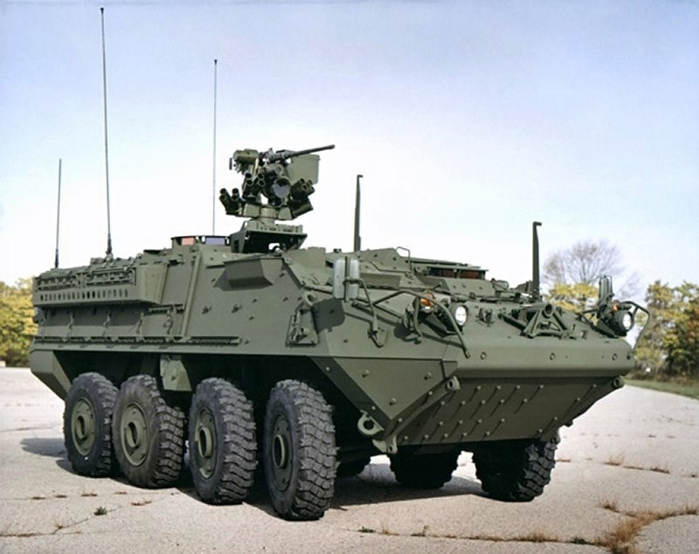
Vehicle
Vehicle:
The IAV (Interim Armored Vehicle) Stryker
M1126 Stryker ICV

Slide 4
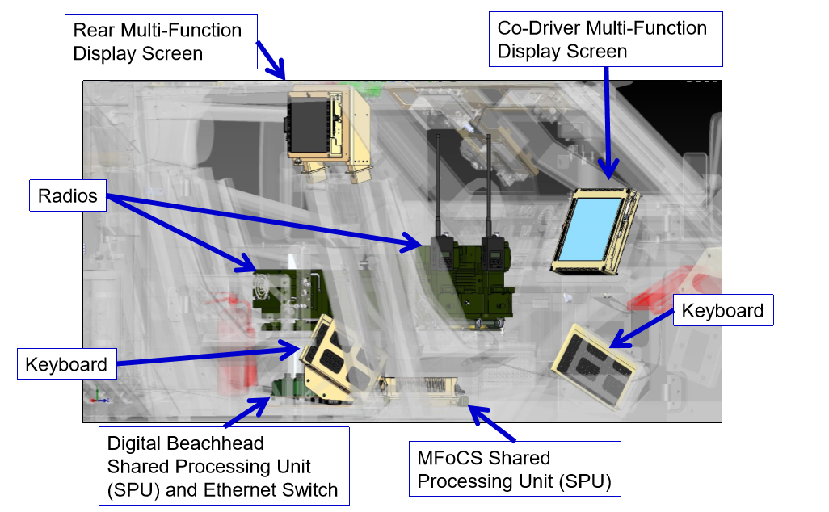
Vehicle Infrastructure
In-Vehicle Network:
A VICTORY-compliant In-Vehicle Network (IVN)
Equipment Used:
An MFoCS Shared Processing Unit (SPU) that host software, shared services (Apps) and data
An Ethernet Switch, connected to the SPU and IVN hardware components (radio, jammer sensors, …)
Interactive Multi-Function Display Unit(s)
Equipment Available:
DBH SPU
Another common SPU used on vehicle
It has an Arm Processor with limited processing power and disk space
In-Vehicle Network

Slide 5
Vehicle Network
VICTORY Data Bus (VDB) Ethernet LAN
SPU to be replaced
AN/PRC-117F
Data Logger, Intercom,
EW, Health
Data Logger, Intercom, EW Mgmt
Native CVRJ IF
(Proprietary)
Data Logger VDM
MFoCS SPU
CVRJ
Ethernet
VCL Instance Document
RS 422
RS 232
Pos, Ori, DoT, GPS Health
Pos, Ori, DoT, GPS Mgmt.
GSSIP
Pos, Ori, DoT, GPS VDM
DBH SPU
DAGR

Slide 6
Operation Flow
Broken/Inoperable MFoCS SPU
Analyze inventory to find replacement
Replacement Not Found
Order replacement SPU and wait for delivery
DBH SPU Replacement Found
3 months wait…
Configure network to satisfy original requirements
Install software to satisfy original requirements
Replacement Delivered
Analyze SPU disk space and adjust Data Logger storage accordingly

Slide 7
Associated Assumptions and Constraints
Assumptions
The SPU is using static IP addresses
The new SPU has a different IP address than the SPU being replaced
All multicast addresses defined in the VCL have unique ports
Constraints
Physical limit of disk space that can be used by Data Logger

Slide 8
Test Objective: Configure Replacement SPU
Initial configuration/requirements for the SPU (MFoCS PU)
Install and run the Data Logger and Electronic Warfare VICTORY component types
All applicable network endpoints of the two component types above shall contain the IP address of the SPU
MFoCS has a common interchangeable 512GB solid state hard drive
Data logger has a maximum log size of 4 GB (in this scenario)
New configuration/requirements for the DBH SPU (Arm processor)
Reinstall and run the Data Logger and Electronic Warfare VICTORY component types
Update all applicable network endpoints to contain the IP address of the new SPU
DBH SPU has 16 GB of on-board Flash storage, and can be increased to 32 GB. Standard SSD storage capacities include 128 GB and 256 GB
If necessary, update maximum log size of data logger based on storage capabilities of new SPU

Slide 9
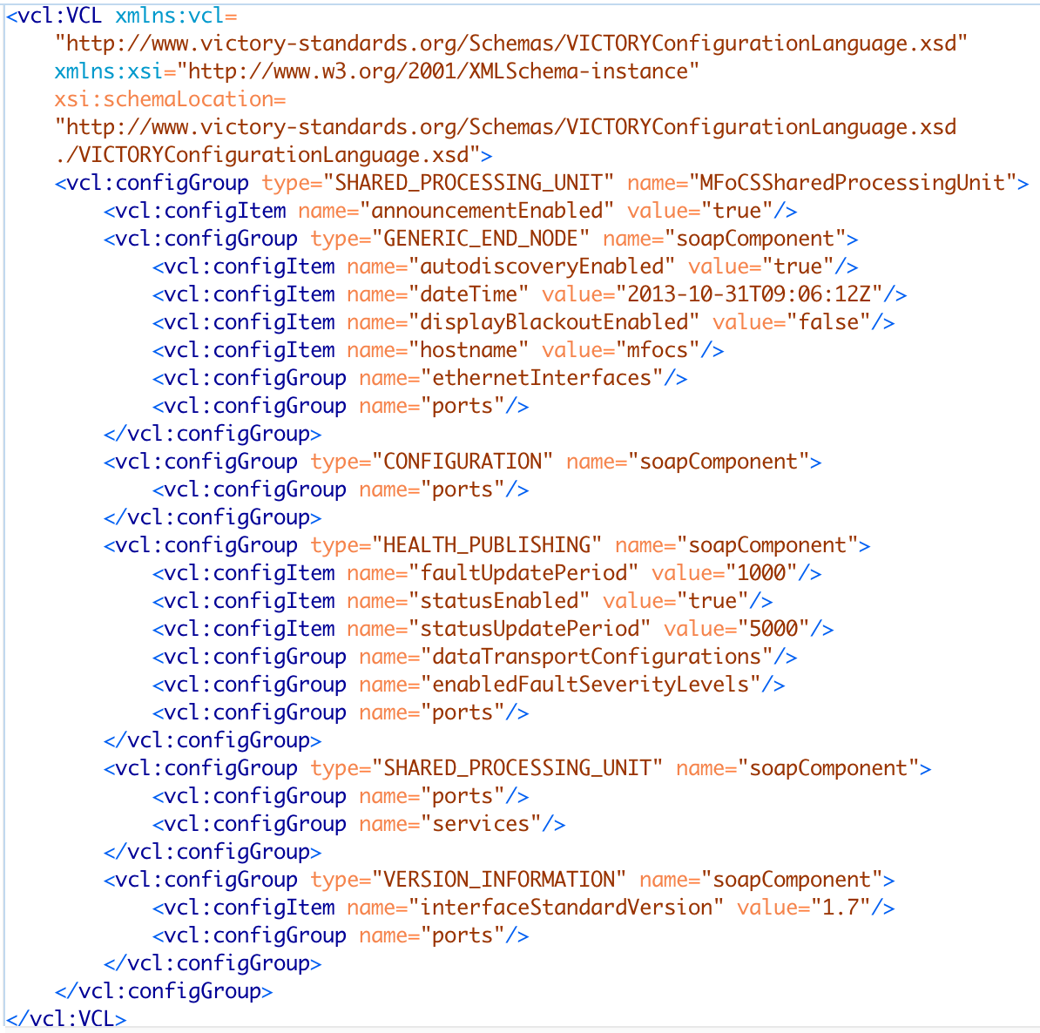
Initial VCL Representation – SPU Internal Structure
A VICTORY Component Type (e.g. SPU) is comprised of a logical breakdown of WSDL-defined SOAP components. Each SOAP component describes a contract for communication between client and service applications. A SOAP component in the VCL provides the current state of the available data.
The Generic End Node SOAP component describes system settings of a generic end node. It also describes the endpoints used to communicate with the SPU service when retrieving or setting parameters related to the generic end node.
The Configuration SOAP component describes the endpoints used to communicate with the SPU service when retrieving or setting the current configuration (VCL) of the SPU.
The Health Publishing SOAP component describes the publishing rates and enabled severity levels of faults on the system, along with the endpoints used to retrieve health data of the SPU service. It also describes the endpoints used to communicate with the SPU service when retrieving or setting parameters related to the health of the SPU service.
The SPU SOAP component describes the VICTORY services installed on the SPU along with the endpoints used to communicate with the SPU service when retrieving or setting parameters related to the SPU.
The Version Information SOAP component describes the version of the VICTORY standards specification implemented on the SPU along with the endpoints used to communicate with the SPU service when retrieving or setting parameters related to version information of the SPU.

Slide 10
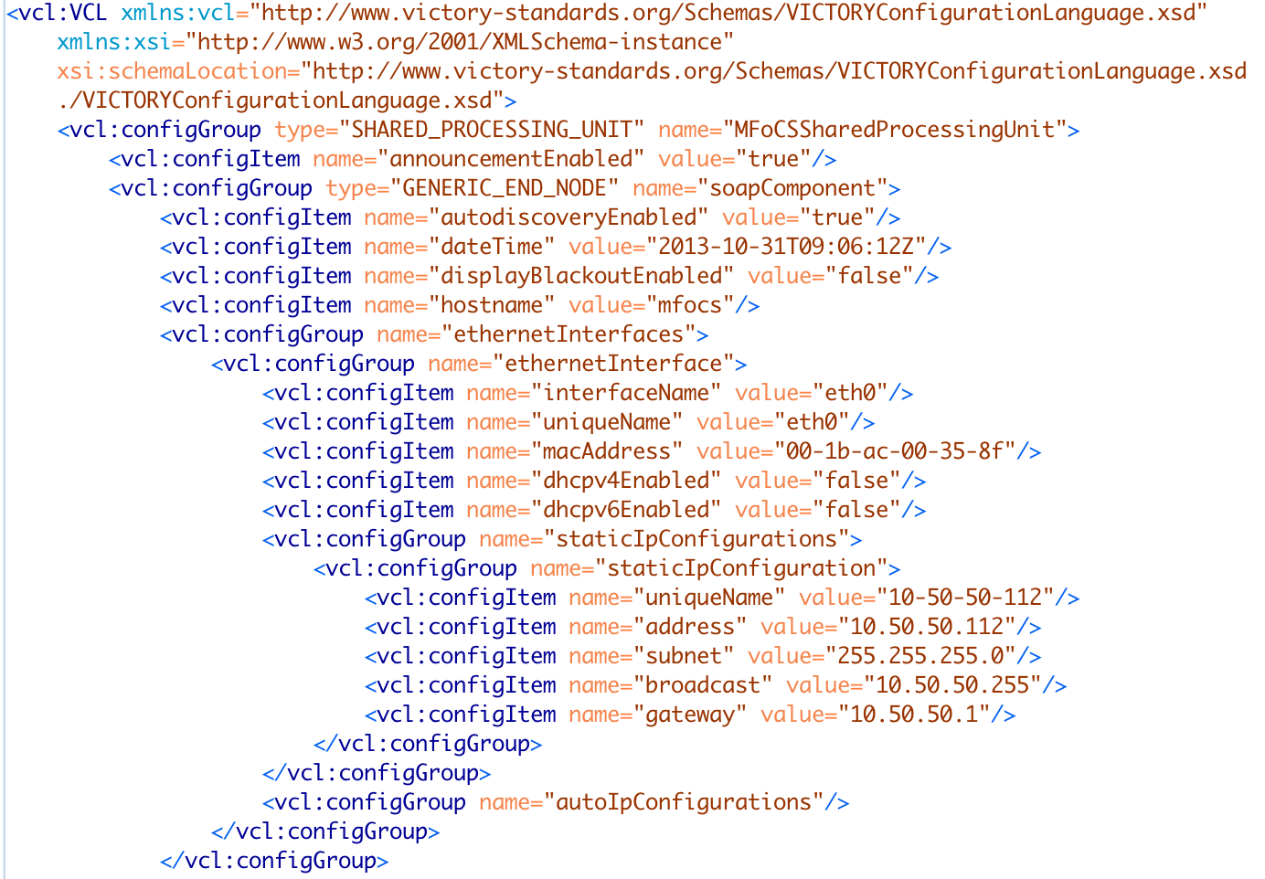
Initial VCL Representation – Ethernet Interfaces
Describes the ethernet interfaces of the SPU. Ethernet interfaces are reportable in VICTORY, meaning they cannot be configured through the VCL.
Ethernet interfaces are obtained from the system settings of the SPU.
When an SPU gets switched out, the ethernet interface information must be manually updated inside the VCL to reflect the network settings of the new SPU.

Slide 11
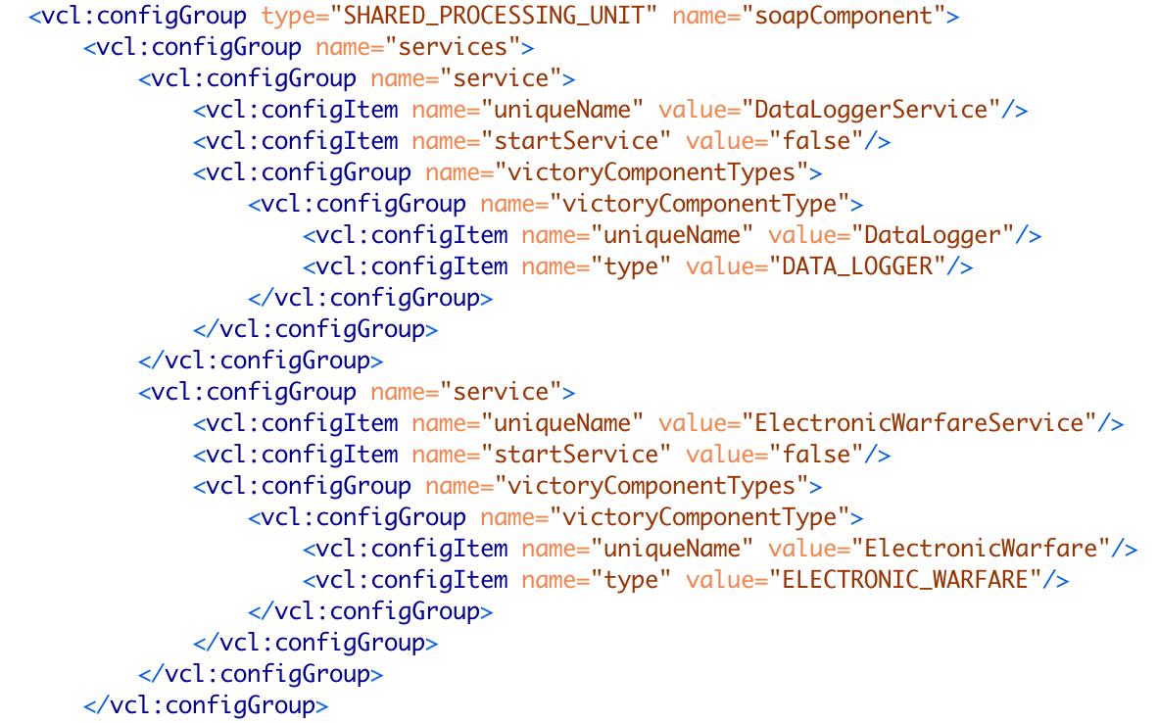
Initial VCL Representation - Services
The SPU SOAP Component portion of the VCL provides a list of VICTORY services installed on the SPU.
Each VICTORY service implements one or more VICTORY component types.
The uniqueName configuration item inside the victoryComponentType configuration group represents the unique name of the VICTORY component type defined inside the VCL.

Slide 12
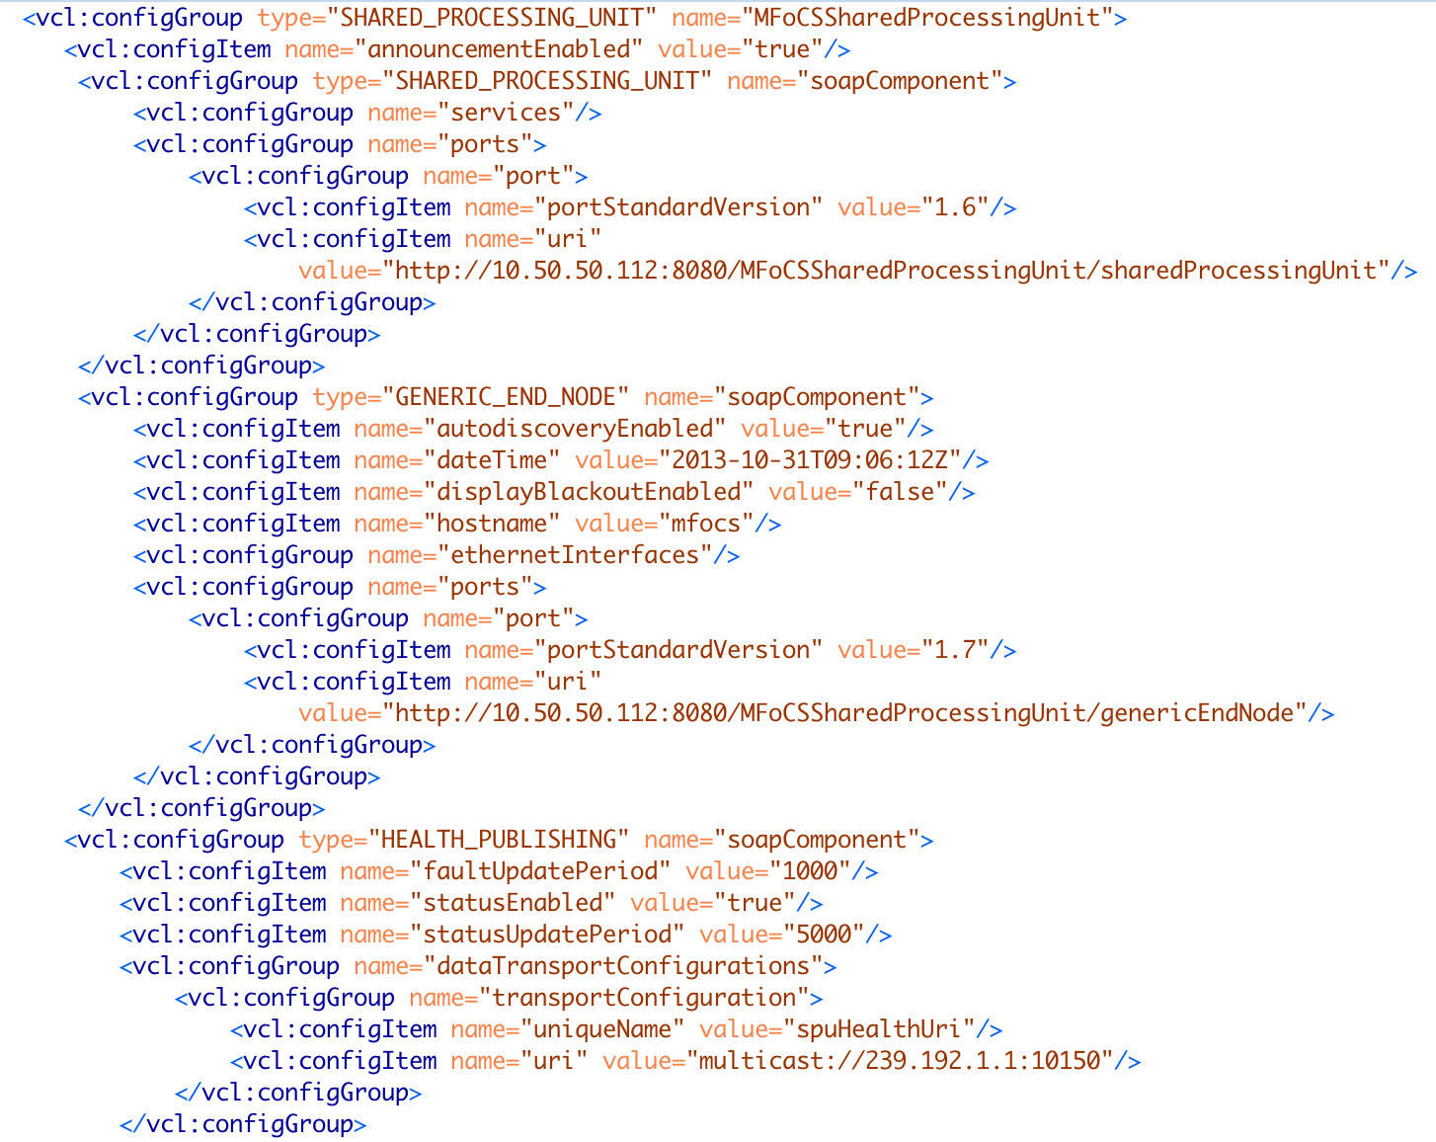
Initial VCL Representation - URIs
Each SOAP component contains a list of ports, where each point is an endpoint used for communicating with a specific SOAP component of a VICTORY service.
Ports are reportable in VICTORY, meaning they cannot be configured through the VCL.
VICTORY defines endpoints as URIs. Each URI contains a host and a port. If changing the SPU causes the host and/or port to change, the URI of every port inside the SPU component type portion of the VCL must be manually updated to reflect the new host and/or port.
Note the example to the left only shows a subset of the ports inside the SPU component type.
Syslog health publishing messages are sent via multicast addresses. These shouldn’t have to be updated when an SPU is changed

Slide 13
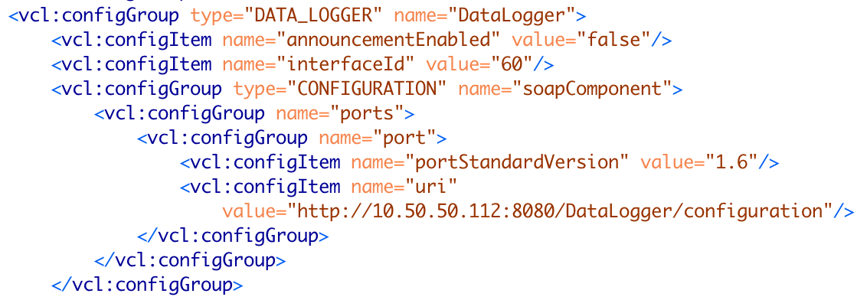
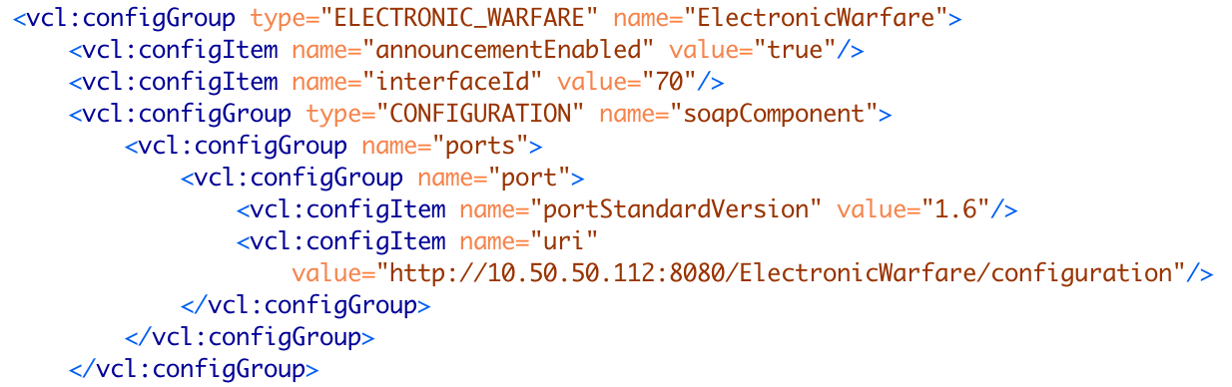
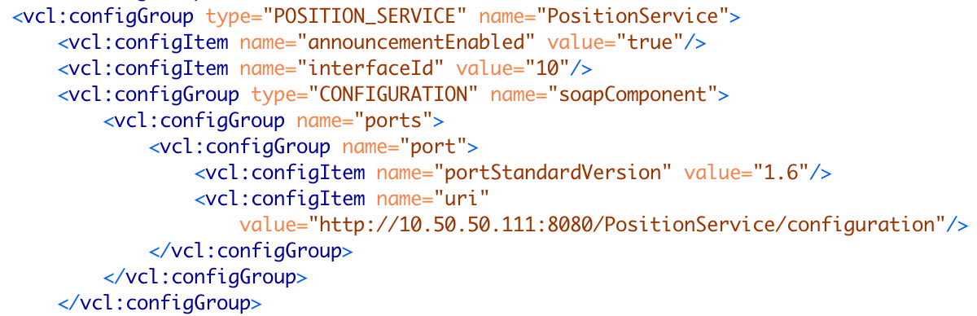
Initial VCL Representation – URIs Cont.
In addition to the URIs inside the SPU component type, all URIs inside VICTORY component types installed on the SPU being added must be updated to reflect the new IP address.
In this scenario, the SPU being added has the Data Logger and Electronic Warfare component types installed on the SPU, so the URIs will need to be updated accordingly.
Note the example to the left only shows a subset of the ports inside the Data Logger and Electronic Warfare component types.
Some vehicle networks will contain more than one SPU. All services running on an SPU not being changed should not be modified. In this scenario, there’s a second SPU running Position, Orientation, Direction of Travel, and GPS services. Those configurations should stay the same in the VCL.

Slide 14
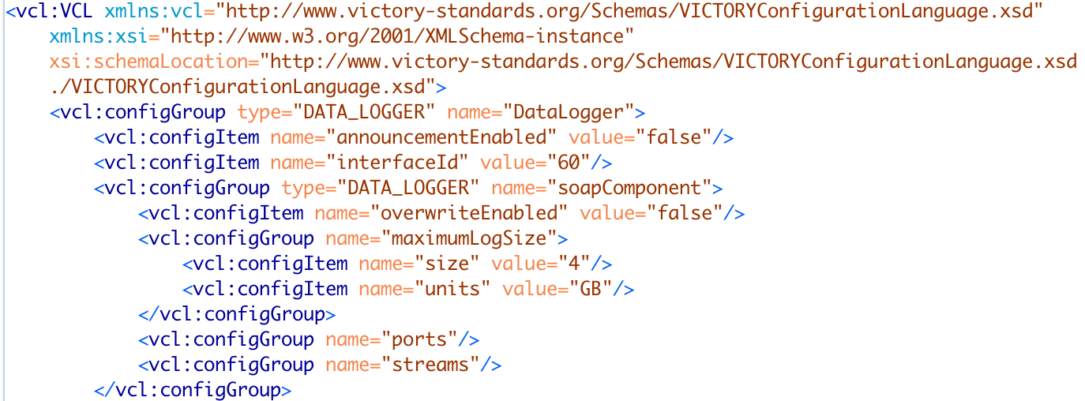
Initial VCL Representation – Data Logger Max Log Size
The Data Logger VICTORY component type allows for VICTORY Data and Health messages to be stored in a log file.
The VCL contains the maximum log size of the Data Logger.
Maximum log size is mutable in VICTORY, meaning it can be configured through the VCL.
If changing the SPU results in a smaller disk space (an Arm processor, for example), the maximum log size of the data logger may need to be adjusted accordingly.
When the maximum log size is updated, the new value takes effect immediately.

Slide 15
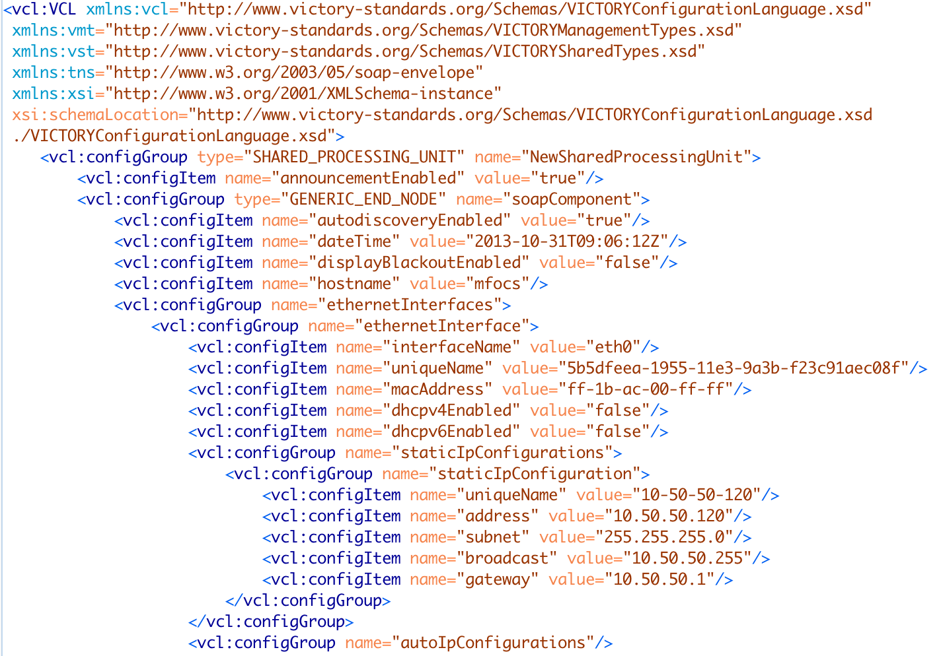
VCL Representation of Ethernet Interfaces with DBH SPU
The name of the SPU has been updated, but this is not required. The only requirement in VICTORY is that the name of the component type (in this case an SPU) is unique within all component types defined inside the VCL. Because the broken SPU is being removed inside the VCL and replaced by the DBH SPU, the name could stay the same and still maintain its uniqueness.
The ethernet interface description inside the VCL has been updated to reflect the ethernet interfaces configured on the DBH SPU. In this scenario, the DBH SPU has a single ethernet interface with an IPv4 address of 10.50.50.120, but this configuration could be anything. All that matters is the ethernet interfaces described inside the VCL match the ethernet interface configuration of the SPU.

Slide 16
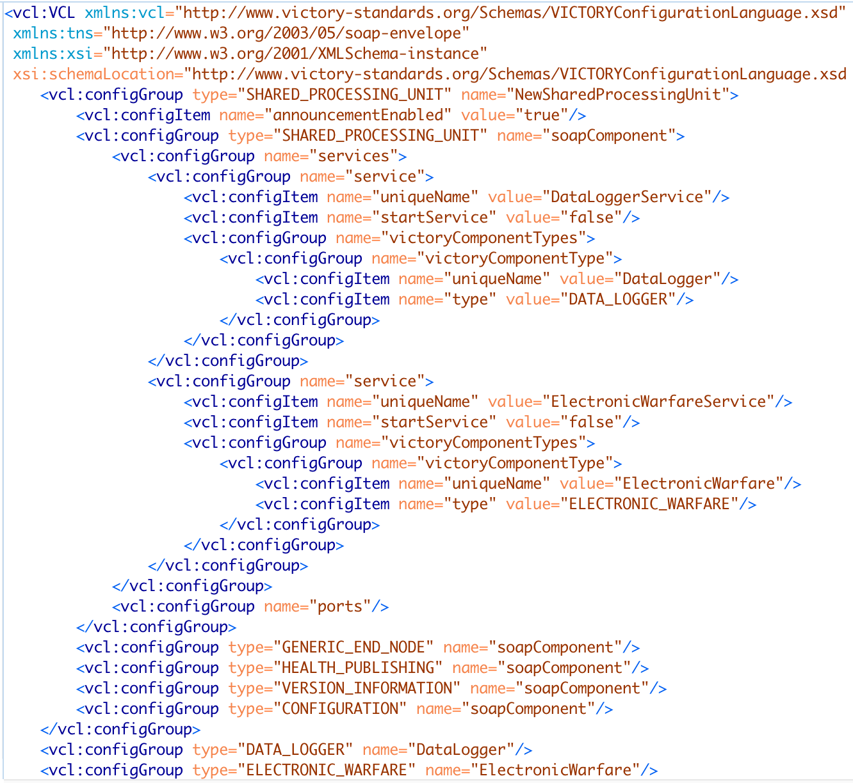
VCL Representation of Services with DBH SPU
DBH SPU needs to maintain the same configuration as the broken SPU. Thus, the DBH SPU should still contain the same list of services as the broken MFoCS SPU.
The services have not been impacted by this update, so each service should still implement the same VICTORY component types.

Slide 17
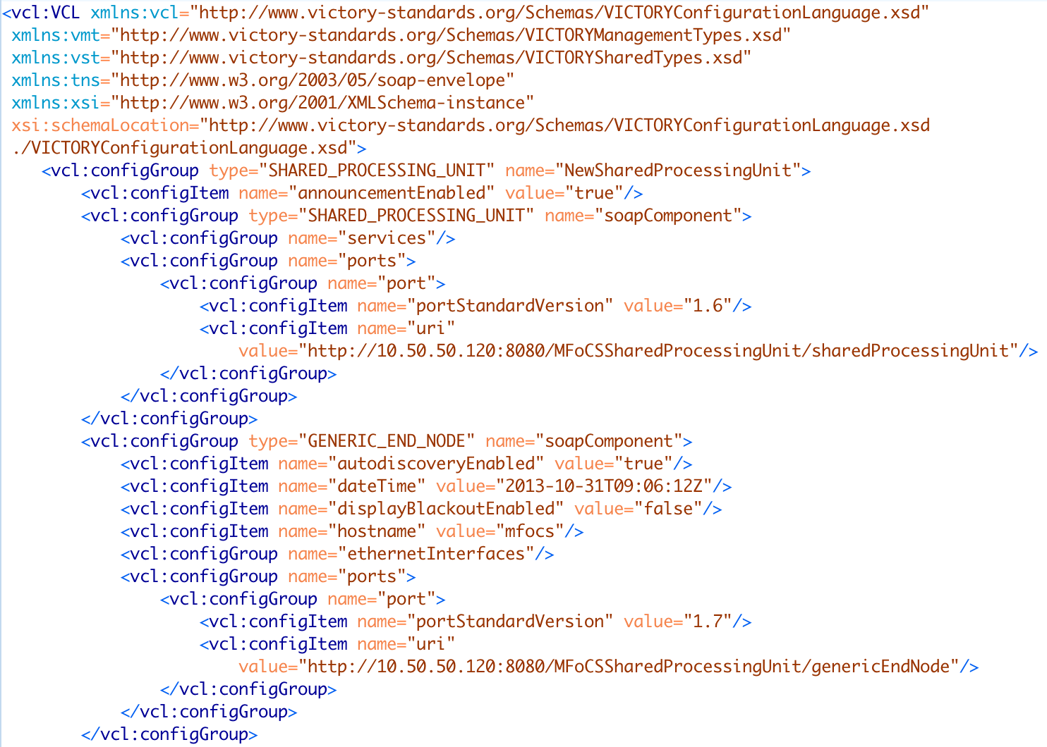
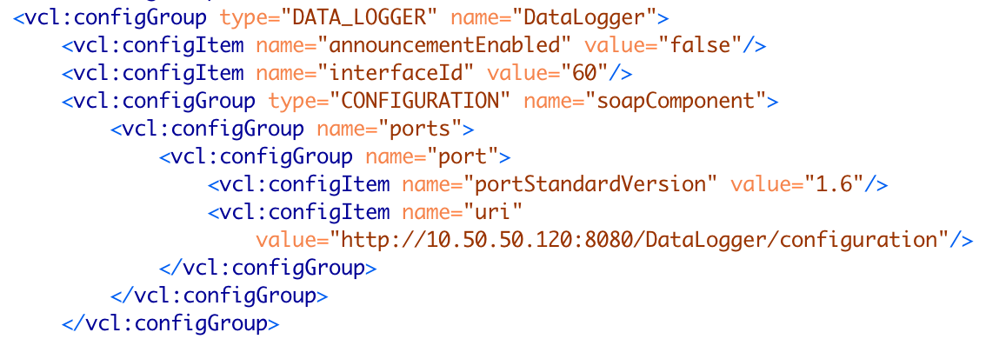
VCL Representation of URIs with DBH SPU
When the IP address of an SPU is updated, the URIs of all VICTORY component types running on the Vendor B SPU must be updated to reflect the new IP address.
In this scenario, the IP address of the new DBH SPU is 10.50.50.120. All URIs defined for the DBH SPU configuration must be updated to reflect the IP address. In addition to the Vendor B SPU configuration, the URIs defined for the Data Logger, Electronic Warfare, and Intercom configurations must be updated to reflect the change in IP address.

Slide 18
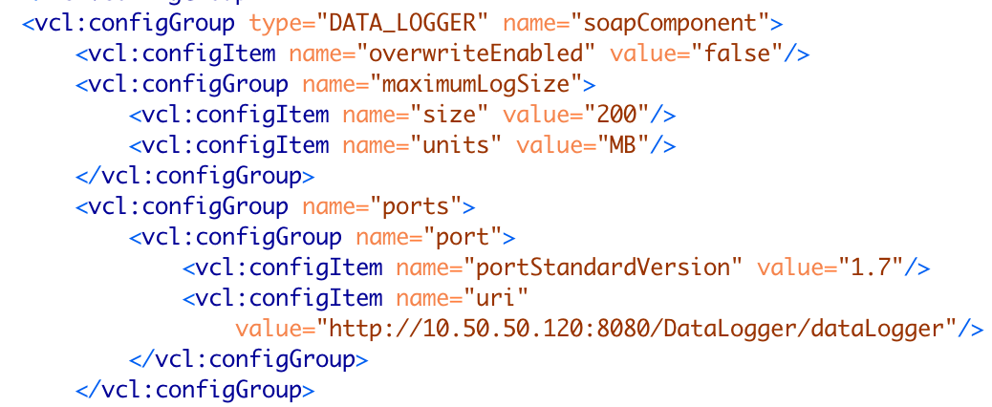
VCL Representation of Data Logger Max Log Size with DBH SPU
DBH SPU is an Arm processor, meaning it will likely have limited hard drive space. Any time an SPU is switched out that is running a VICTORY Data Logger service, the available disk space of the SPU needs to be looked at to determine if the maximum log size of the Data Logger needs to be adjusted.
In this scenario, the DBH SPU had limited hard drive space so the maximum log size was reduced from 4 GB to 200 MB.

Slide 19
Cost, Value and Risk
 | COST | VALUE | RISK
Option A: Use MFoCS SPU Spare | SPU cost: Free Spare SPU is available on hand (Purchase cost is $8k) | 100% - configuration and hardware are identical to current | Risk Level: 4 Likelihood of later programs requiring spares is high, stock is very limited
Option B: Order new MFoCS SPU | SPU Cost: $8k Additional cost: Time SPU must be delivered before it can be used | 100% - configuration and hardware are identical to current | Risk Level: 1 Same SPU means risk is low
Option C: Use DBH SPU | SPU Cost: Free Spare SPU is available on hand (Purchase cost is $5k) | 90% program value – Vendor B has a slower processor and limited disk space, impacting Data Logger storage | Risk Level: 2 New SPU to adapt to but no cost due to having a spare

Slide 20
Classic Solution
Option A and B
VCL will still needed to be updated to account for a potential change in ethernet interface configurations, but having the same processing speed and disk space prevents there from having to be any other updates made to the VCL.

Slide 21
Suggested Solution
Use available SPU in inventory and configure to satisfy original requirements
VCL needs to be updated to reflect the new ethernet interfaces and disk space limitations
Review disk space of new SPU and adjust Data Logger log size accordingly
Map ethernet interfaces of new SPU to the ethernet interfaces described inside the VCL
Ensure all URIs defined for services running on the new SPU are updated with the correct IP address

